Slide 1
GLOBAL SALES PERFORMANCE
&
STRATEGIC RECOMMENDATIONS

Slide 2
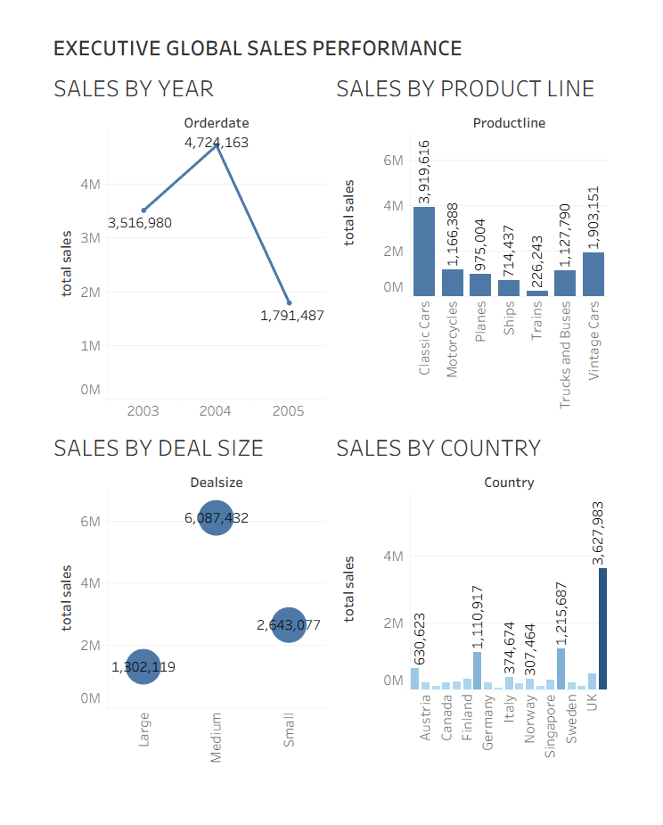
Global Sales Performance:
Data-Driven Insights (2003-2005)Dashboard Objective To provide executive stakeholders with an interactive, single-view summary to monitor core financial health, analyze key sales trends, and guide immediate strategic decisions.
Primary Conclusion:
The business is fundamentally strong but shows extreme reliance on Q4 performance and the sales success of Classic Cars in the USA. Strategic focus should be on mitigating the Q1/Q2 sales drop.

Slide 3
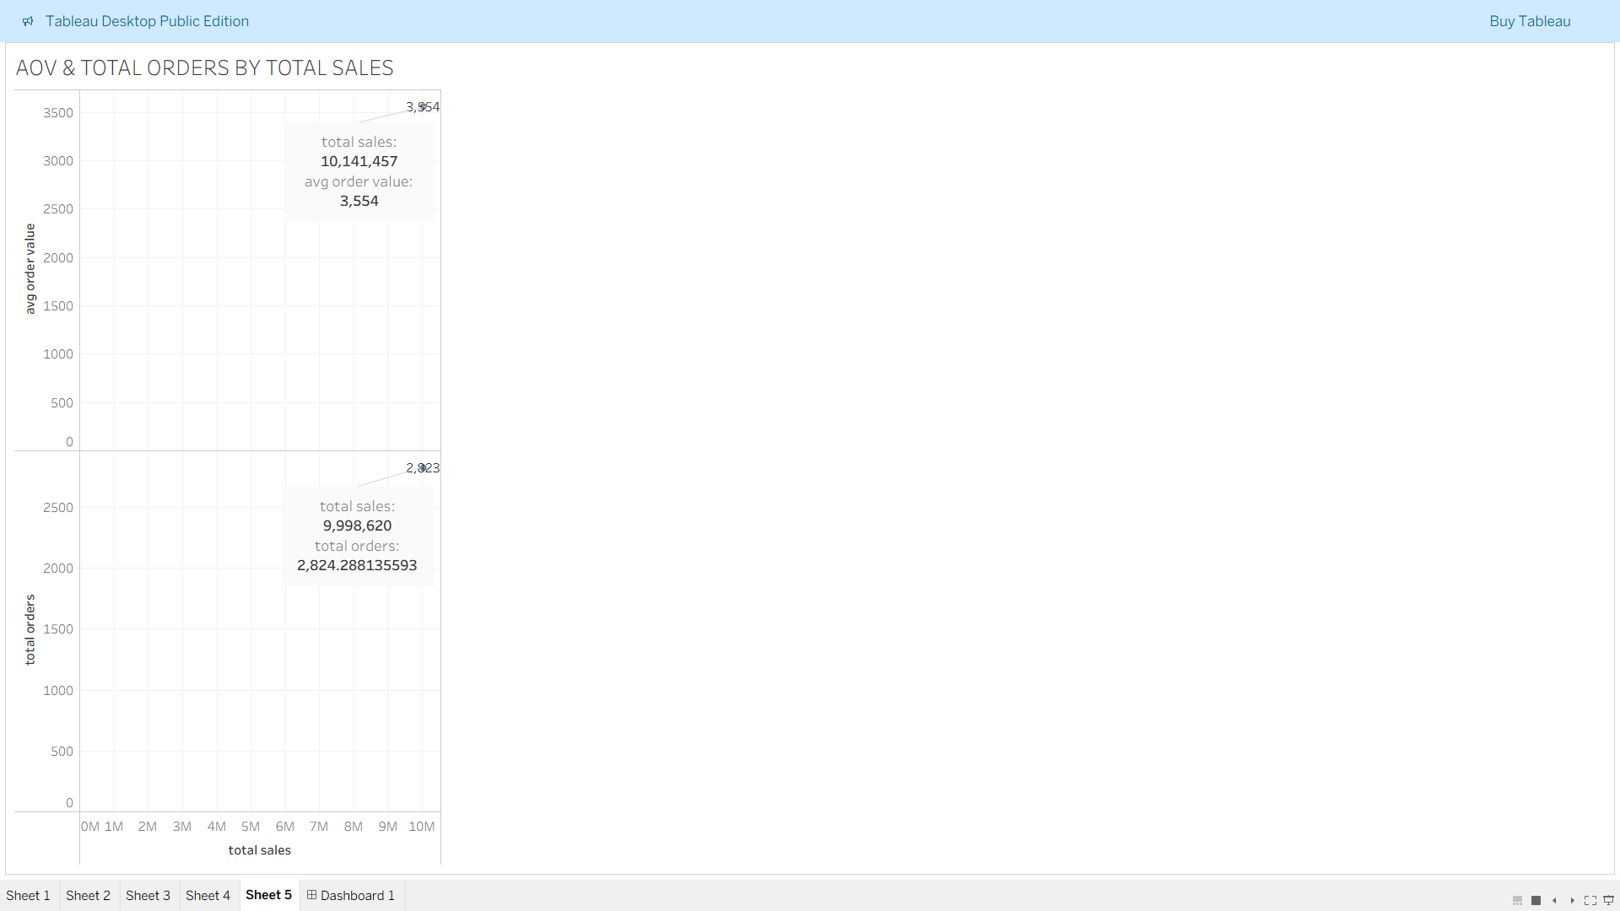
Global Sales Performance & Strategic Action Plan
Key Performance Indicator (KPI) :
Total Sales: $11.2 Million (Primary Revenue Metric)
Total Orders: 2,823 (Volume Metric)
Avg Order Value (AOV): $3,975 (Transaction Quality Metric)

Slide 4
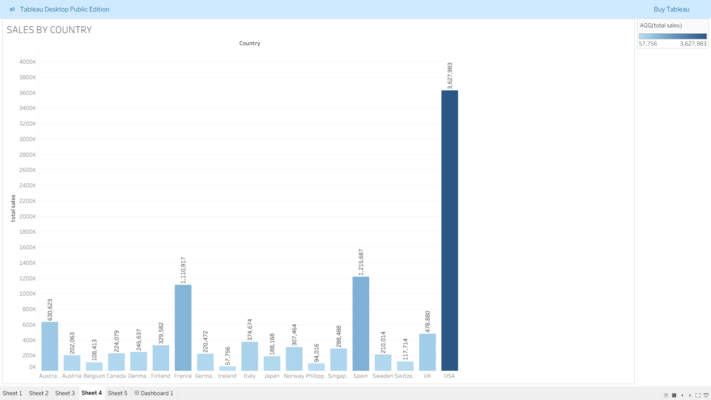
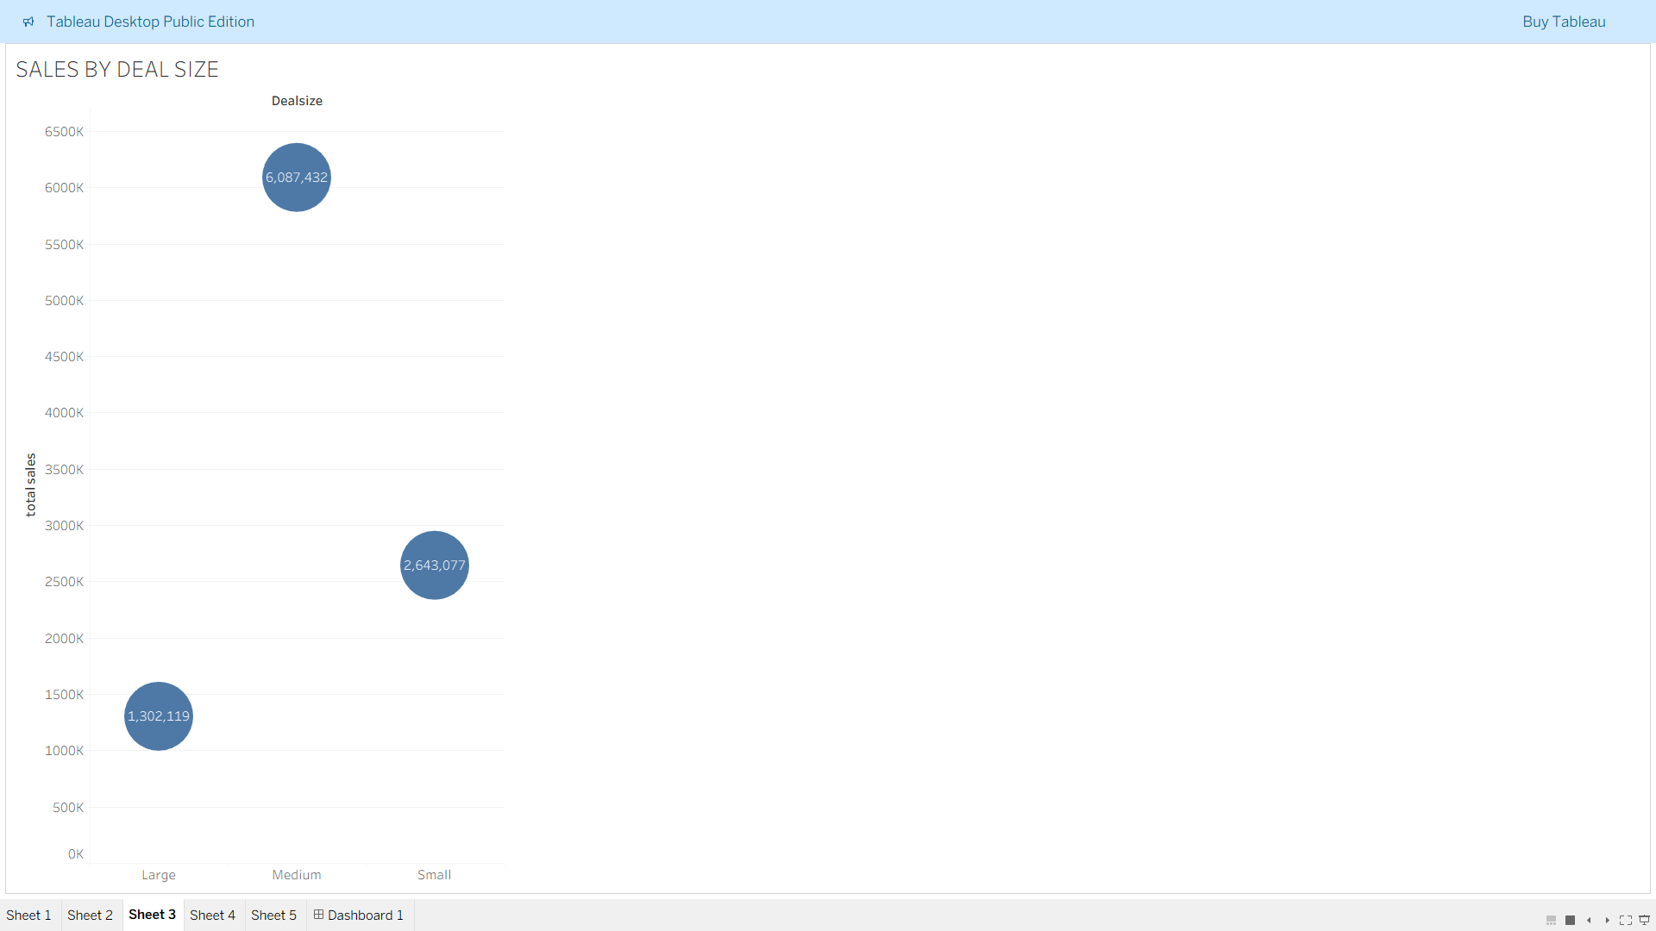
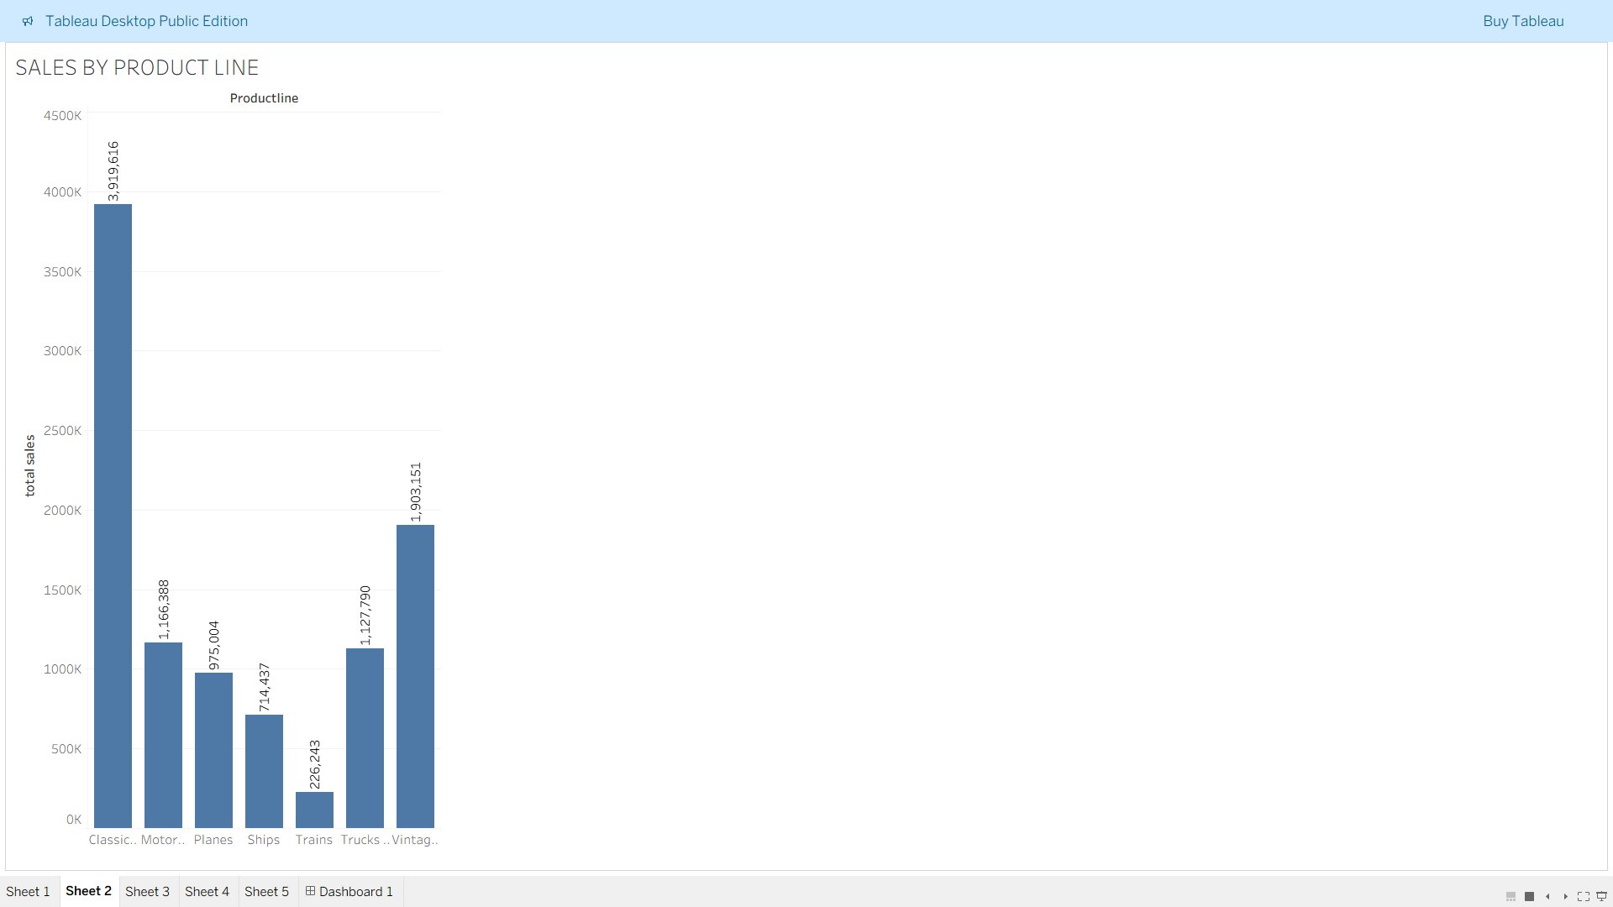
Executive Insight:
Sales performance is strong, but the business shows extreme reliance on Q4 seasonality and the success of the Classic Cars line in the USA.

Slide 5
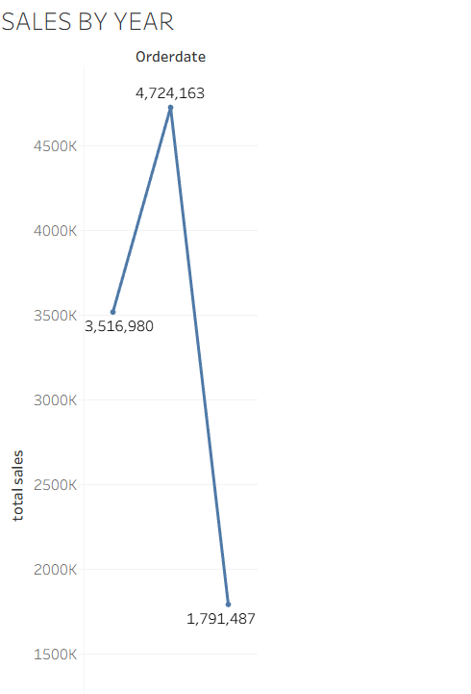
Trend Analysis : Mitigating the Q4 Peak & Q1 Drop
Key Finding: Extreme Sales Seasonality
The business exhibits a pronounced, predictable sales spike at the end of every year.
Q4 (October – December) consistently generates 35% to 40% of total annual revenue.
Strategic Implications:
High Risk: A disruption in supply chain or marketing execution during Q4 could critically undermine the entire year's results.
Low Season: The steep sales drop in Q1 and Q2 requires a dedicated strategy to stabilize cash flow and maintain consistent factory/operations output

Slide 6
Where & What: Revenue Hotspots and Growth Opportunities
Product Performance (The "What"):
Top Performers: Classic Cars is the largest category, and Motorcycles maintains the highest AOV. Together, they form the core 50% of the sales engine.
Underperformers: Lines like Ships and Planes contribute significantly less revenue and should be targeted for specific promotions or assortment review.
Geographic Performance (The "Where"):
Dominant Market: The USA is the single largest driver, contributing over 35% of all revenue.
Growth Markets: Sales figures from APAC and certain EMEA countries are low relative to market size, signaling untapped potential if targeted through regional campaigns (use slicers to investigate locally).

Slide 7
Transaction Efficiency: Focusing on High-Value Customers
1. Order Quality Summary:
AOV: The average order value of $3,975 is excellent, validating the company's pricing model for high-value goods.
Distribution: Revenue is primarily generated through a stable volume of 'Medium' deals.
2. Opportunity for Profit Maximization:
The highest profit margins come from the relatively few 'Large' deals.
Actionable Insight: The focus must shift to customer lifecycle management—converting existing 'Medium' deal customers into the more valuable 'Large' bracket.

Slide 8
Actionable Strategy & Next Steps
1: Maximize Q4 Profit
Action: Increase inventory reserves and dedicated marketing spend for Classic Cars and Motorcycles by 20% starting in September (Q3) to prevent stock-outs during the peak season.
Target KPI: Secure text 40% of annual sales in Q4.
2: Stabilize Low Season
Action: Launch an aggressive 'Early Year Discount' campaign targeting the lower-performing Ships and Planes categories immediately in January to smooth Q1/Q2 cash flow.
Target KPI: Increase Q1 text Total Orders by text 10% YoY.
3: Cultivate Large Deals
Action: Implement a loyalty or outreach program that targets customers who have purchased three or more 'Medium' deals with an exclusive incentive to convert their next purchase into a 'Large' deal.
Target KPI: Increase 'Large' Deal revenue contribution by text 15%.

Slide 9
THANK YOU ☺

